Slide 1
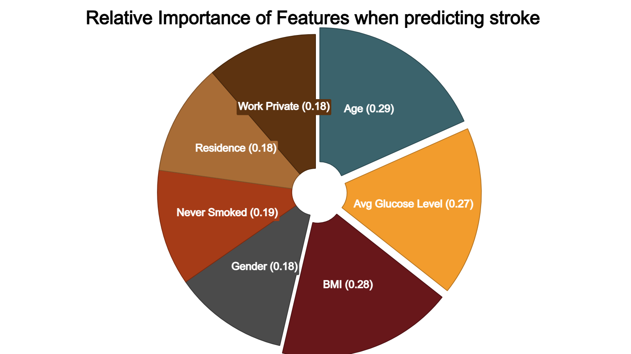
How did the model perform? What did the data show?
More Stroke Patient Data
The model achieved 97% accuracy. Imbalance over sampling was used to correct having 246 stroke observations and 4860 no stroke observations. More stroke target values will improve the reliability of the model.
Age, BMI, and Glucose are important
The model identified age, BMI, and average glucose level are important when predicting a stroke.
What did the data show?
• Age range: 0.80 to 82. Average: 43.
• Age range for stroke patients: 40- 80
• Average glucose level for stroke patients: > 100
• BMI for stroke patients: 20- 60

